Slide 1
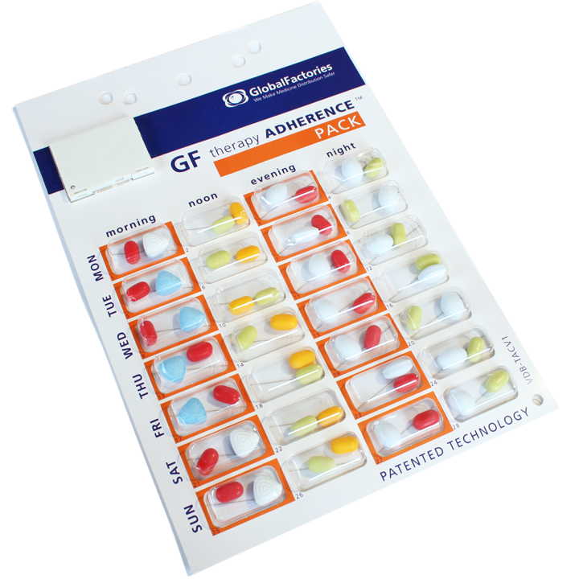

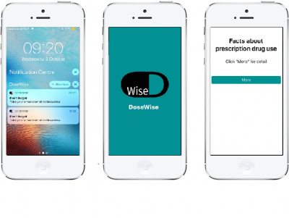
TABLE
Harmful Substances, DoseWise, TP104
11
http://www.dosewise.tk
Topic : Harmful Substances (tobacco, alcohol, drugs)
DoseWise : Managing your Prescriptions Wisely
“A Digital Blister Pack to manage prescriptions through an App”
Notes:
Create 3 slides (You do not do presentation for these, these slide will be displayed as kiosk mode during your expo)
No. is your Table number
You must follow the style mentioned in this page, do not change the heading layout (Include the alignment and link color)
Example of link: https://hhhh.xx/
You decide where to put things in the body, Please think about what do you need to consider?
Slides shall include pictures of team working (not just smiley faces and finger signs)
Picture or pictures of your applications, pictures of your target audience, anything you consider will make an impression
Description in 3 – 4 sentence of what your app does
Your mentors will check this power point
If you do not follow the requirement, you and your team will be asked to redo
No animations/ Transition inside the slide

Slide 2
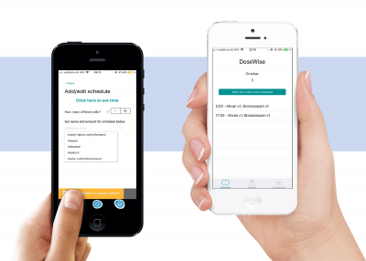
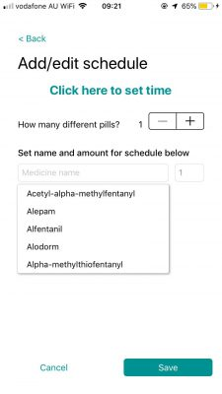
Harmful Substances, DoseWise, TP104
11
http://www.dosewise.tk
Topic : Harmful Substances (tobacco, alcohol, drugs)
What is DoseWise?
Dose Wise is a Medical Prescription Management App
Features:
Schedule multiple prescription intakes
Remind users to take their medication
Launch Quizzes to check user condition
Send notifications to nominated person in case of emergency
Provide Drug Information & Visualized Knowledge

Slide 3
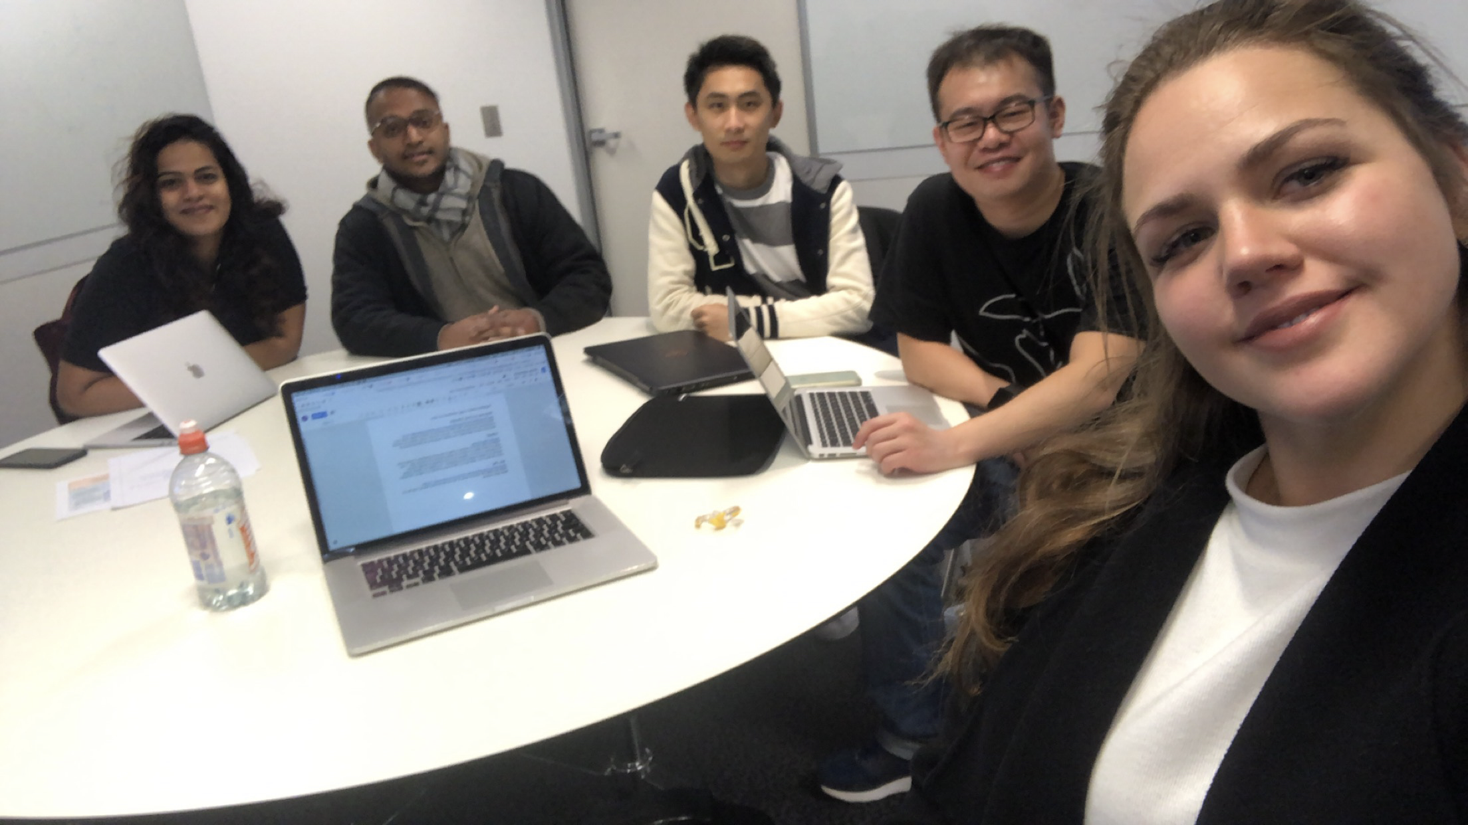
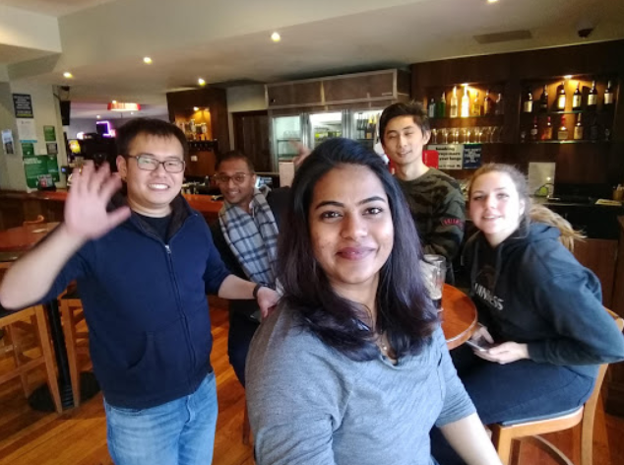
Harmful Substances, DoseWise, TP104
11
http://www.dosewise.tk
Topic : Harmful Substances (tobacco, alcohol, drugs)
THE TEAM BEHIND DOSEWISE

